Slide 1

5th International conference on Recent Trends in Machine Learning, IOT, Smart Cities & Application (ICMISC 2024)
28-29 March 2024,
CMR Institute of Technology, Hyderabad, India
Title of Paper:- Deep Neural Network Architecture for Cardiac Structures Segmentation Paper ID:- 159
Track Name:- 5B(5B): Medical Artificial Intelligence
Presenters Name & Affiliation:- Abdul Razzak R Yergatti
Name of All the Authors:- Abdul Razzak R Yergatti, Vinayak Suresh Bhajantri and Rahul B Sajjan

Slide 2
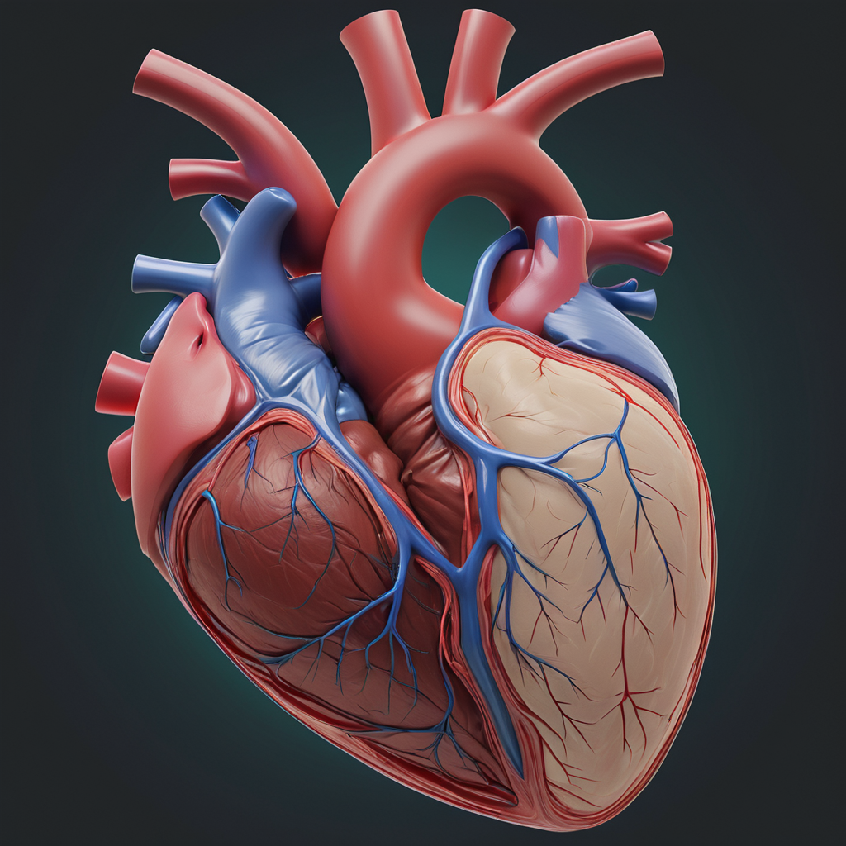
Introduction
The heart is one of the most vital organs in the human body.
It supplies blood to every part of the body and is situated in the middle of the chest, it is frequently referred to as the engine of the human body.
According to research, cardiovascular diseases claim the lives of 17.3 million people year globally, with 80% of these fatalities occurring in low- and middle-income countries.
In addition, it appears that by 2030, 23.6 million people would have died from cardiovascular diseases.

Slide 3
Introduction
The traditional automated learning algorithms are unable to divide the whole heart. In turn, the U-Net model for biomedical cardiac medical image segmentation has been applied in this research.
The suggested U-Net model uses an encoder that has been enhanced using transfer learning techniques, which enables it to learn from a small quantity of input efficiently.
Our primary goal is to classify the myocardium accurately, both left and right valve views in our segmented envision, while segmenting the whole heart image. This component enhances the model’s ability with additional classification and localization, providing improved precision and accuracy in both aspects.

Slide 4
Literature Survey
Objective of the study | Datasets | Publicly available | ML/DLalgorithm | Accuracy/ Performance | Challenges | Reference
Volume and Ejection Fraction | CT | No | Sparse Regression, CNN | Accuracy-68 | Accurate detection of Ejection Fraction | [13]
Left Ventricle | MRI | No | CNN, RNN | Accuracy-70, Precision-68 | LV metrics into cardiac function parameters | [14]
LV and cardiacphases | CMRI | No | CNN | Accuracy-74, Precision-65 | Limited availability of datasets for accurate segmentation | [15]
Left Ventricle and Right Ventricle | 2DMRI | No | CNN,U-Net | Accuracy-86 | Segmentation of RV is difficult due to limited datasets | [12]
Segmentation of ventricular boundaries | MRI | No | Dynamic Programming, Gradient Descent | Accuracy-75 | Segmentation of internal cardiac structures | [11]
LV,LA,multi-chamber, Coronary Artery, and Aortic valve segmentation | CT,MRI | Yes | CNN, RNN | Accuracy-95, Precision-86 | Smart Imaging, Deep learning techniques in segmentatioon | [10]
Shape and Contour segmentation | CT | Yes | DT,CNN | Accuracy-95 | DT is not suitable for whole cardiac segmentation | [4]
Segmentation of left ventricle(LV) from echocardiograms | CT,CMR | No | ConvolutionalL STM, U-Net | Accuracy-97 | Operator-dependent variability in echocardiography data | [16]
One-step detectionand image segmentation of whole heart segmentation | CT | Yes | DCNN,U-Net, FCNN, R-CNN | Precision-70 | Processing small patches of volume | [18]

Slide 5
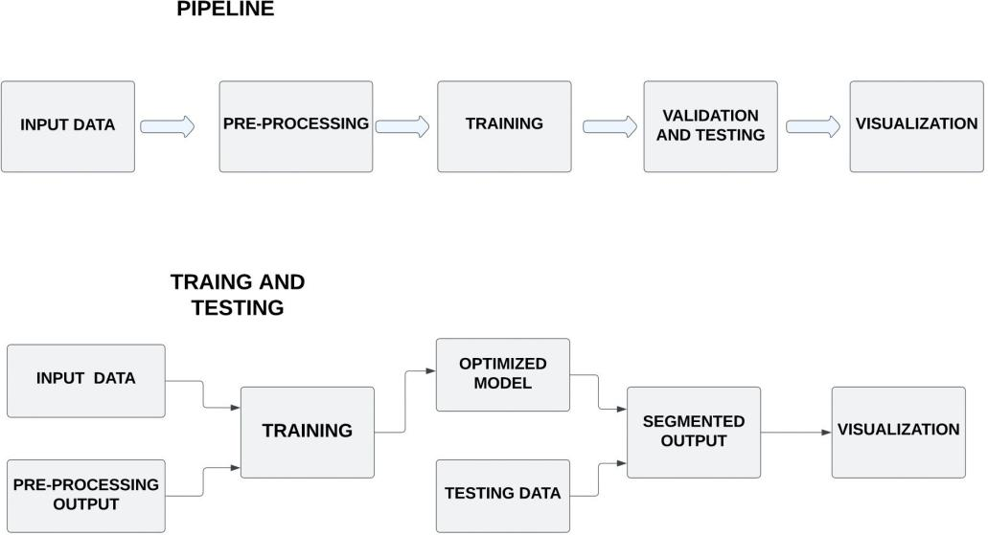
Method

Slide 6
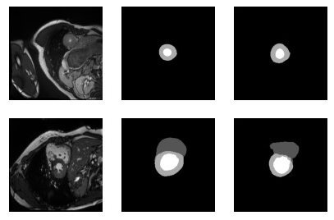
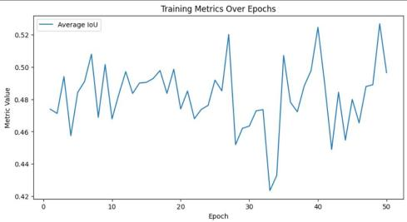
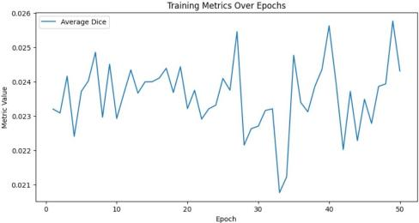
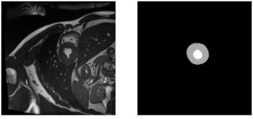
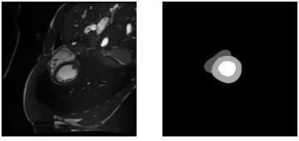
Result
Input image ground truth image segmented image
IOU Score Epoch Dice Loss Over Epochs
Input image Segmented image
Input image Segmented image

Slide 7
Discussion
Why U-Net model is useful for cardiac image segmentation?
The U-Net model is trained by passing in images to the model we can produce an initial guess at the ground truth mask initially guess won’t be accurate we can still use it to compare against our ground truth label this comparison gives us an error, we can use to adjust the model’s parameters meaning that the next time we pass in an image we’ll have a slightly better prediction so why is this model so effective when working with high-resolution inputs and outputs.
The encoder in the U-Net model is in charge of retrieving aspects of the input imagery, decoder is in oversight of sampling intermediate features and attracting the final output.
Challenges: One of the major problems in cardiac image segmentation was the availability of the dataset. Thus we have collected a total of 5000 masked images and 5000 heart images. The dataset consists of five classes (normal case, dilated cardiomyopathy, abnormal right ventricle, heart failure with infarction, and hypertrophic cardiomyopathy).

Slide 8
References
1.B Norrving, S Mendis, S Davis. Global status report on noncommunicable diseases, switzer- land world health organization. 2, 2014.
2.B. Norrving, S. Mendis, P. Puska. Global atlas on cardiovascular disease prevention and control.World Health Organization in collaboration with the World Heart Federation and the World Stroke Organization. pp.3-18, 2011.
3.Z.Li A. Lin and X.Yang. "A network of simultaneous segmentation and registration for right ventricle MRI,.IEEE International Conference on Bio-Informatics and Bio-Medicine (BIBM), Seoul, Korea (South), pp. 657-662, DOI: 10.1109/BIBM49941.2020.9313411. 2020.
4.W. G. Hundley, R. B. Stacey. The role of cardiovascular magnetic resonance (CMR) and computed tomography (CT) in facilitating heart failure management. current treatment options in cardiovascular medicine.15(4) (2013) 373-386. 2013.
5.T. H. Hauser S. B. Yeon L. Goepfert K. V. Kissinger W. J. E. V. Gelfand, S. Hughes. Man- ning, severity of mitral and aortic.
6.Bai W, Dacher JN, Grosgeorge D, Caudron J et al. Petitjean C, Zuluaga MA. Right ventricle segmentation from cardiac MRI: a collation study. Med Image Anal.19:187–202. doi: 10.1016/j.media.2014.10.004. 2015.
7.Gooya A Shao L Petersen SE Frangi AF. Peng P, Lekadir K. A review of heart chamber segmentation for structural and functional analysis using cardiac magnetic resonance imaging. Magn Reson Mater Phys Biol Med. 29:155–95. doi: 10.1007/s10334-015-0521-4 2016.
8.Amini AA. Tavakoli V. A survey of shaped-based registration and segmentation techniques for cardiac images. 117:966–89. doi: 10.1016/j.cviu.2012.11.017. 2013.
9.Bloch I Funka-Lea G. Lesage D, Angelini ED. A review of 3d vessel lumen segmentation techniques: models, features and extraction schemes. Med Image Anal.,13:819–45. doi: 10.1016/j.media.2009.07.011. 2009.
10.Huaqi Qiu1 Giacomo Tarroni 1, 2 Jinming Duan3 Wenjia Bai 4, 5 Chen Chen1 *, Chen Qin1 and Daniel Rueckert 1. Deep learning for cardiac image segmentation: A review.
11.Gupta, A., et al. "Cardiac MRI image segmentation using deformable models." computers in cardiology 1993, proceedings... IEEE, 1993.
12.Alain Lalande Zotti, Zhiming Luo and Pierre-Marc Jodoin. Convolutional neural network with shape prior applied to cardiac MRI segmentation clement.
13.M. Bhaduri W. Xue, A. Islam, and S. Li. “direct multitype cardiac indices estimation via joint representation and regression learning,” IEEE Transactions on Medical Imaging., vol. 36, no. 10, pp. 2057–2067. 2017.
14.S. Pandey S. Leung W. Xue, G. Brahm, and S. Li. “full left ventricle quantification via deep multitask relationships learning,”. vol.43, pp. 54–65, 2018.
15.M. Khened et al. “Densely connected fully convolutional network for short-axis cardiac cine MRI image segmentation and heart diagnosis using random forest,”. 2017.
16.Liao Z Behnami D Abdi A Vaseli H et al. Jafari MH, Girgis H. A unified framework integrating recurrent fully-convolutional networks and optical flow for segmentation of the left ventricle in echocardiography data. in: Deep learning in medical image analysis and multi-modal learning for clinical decision support. 2018.
17.A generative adversarial model for right ventricle segmentation. (accessed September 1, 2019).
18.Feng J. Xu Z, Wu Z. CFUN: combining faster R-CNN and U-Net network for efficient whole heart segmentation. (accessed September 1).2019.
19.Lamata P Montana G. Int J Comput Assist Radiol Surg. Savioli N, Vieira MS. Automatic bi-plane left ventricular ejection fraction estimation with mobile point-of-care ultrasound using multi-task learning and adversarial training. 2019.

Slide 9
Thank You

